Slide 1
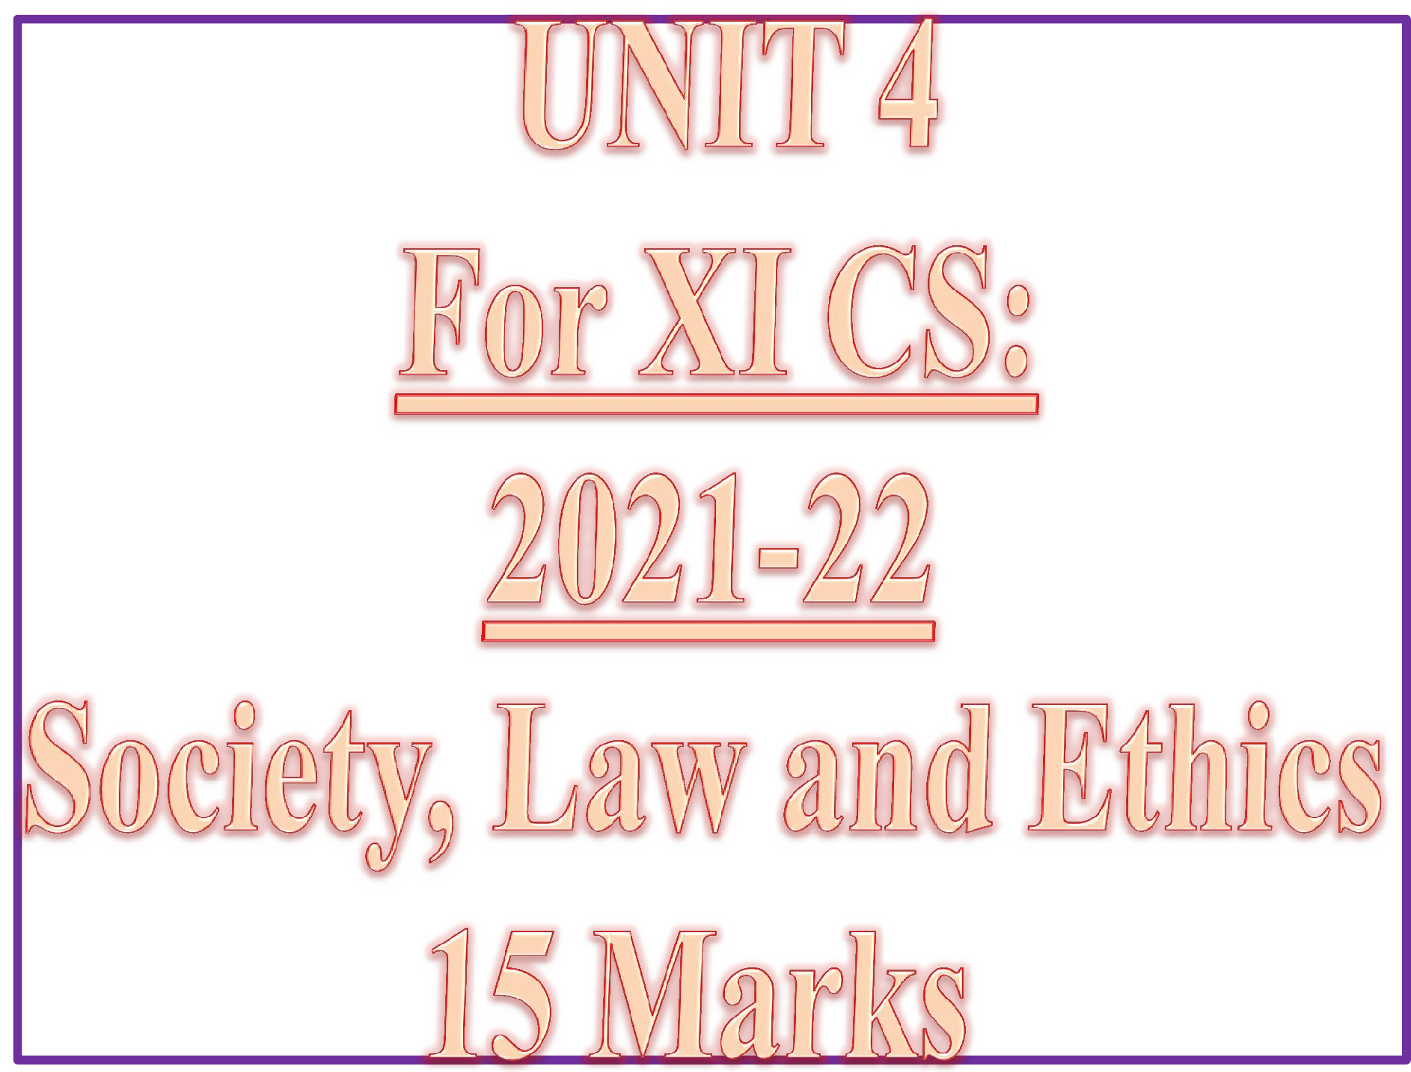

Slide 2
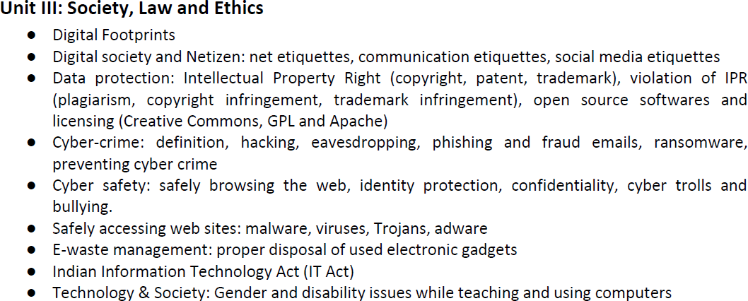
CONTENTS ( Learning Outcomes ) ☺
XI CSc 2021-22
In TERM-2 MARKS-15

Slide 3
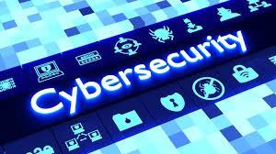
“Be smart, but don’t let the technology be smarter than you. Let your brain work more than your fingers.”
-- Payal Bhattacharjee

Slide 4

Cyber Safety refers to the safe and responsible use of Internet to ensure safety and security of personal information and not posing threat to anyone else’s information.
It involves gaining knowledge about possible threat to personal safety and security risks for the information along with measures to prevent and counter them.

Slide 5
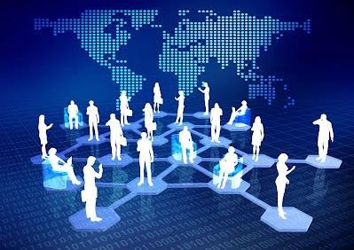

DIGITAL SOCIETY AND NETIZENS
A Digital Society is an interdisciplinary research area and a kind of progressive society that has been formed as a result of adaptation as well as integration of advanced technologies into the society and culture.
Digital innovations are reshaping our society, economy and industries with a scale and speed like never before.
Mobile and cloud technologies, Big Data and the Internet of Things offer
unimaginable opportunities, driving growth, improvement of citizens’ lives
and efficiency to many areas including health services, transportation, energy, agriculture, manufacturing, retail and public administration.

Slide 6
NET AND COMMUNICATION ETIQUETTES
What you should do- USAGE RULES
Be Authentic / honest ( Have honest and clear views, don’t boast)
Use a disclaimer (Your personal views are yours)
Don’t pick Fights Online (Constructive posts by choosing right words)
Don’t Use Fake Names or Pseudonyms (Be yourself)
Protect your Identity (NEVER provide your full name , parents’
details, phone no., address online)
Does your information/ Post pass the Publicity Test ?
Respect your audience (No slangs/obscenity/insults)
Respect other’s Sentiments (Respect others’ privacy and be
considerate to sensitive topics-Politics, Religion)
Monitor comments (Review and approve comments)

Slide 7
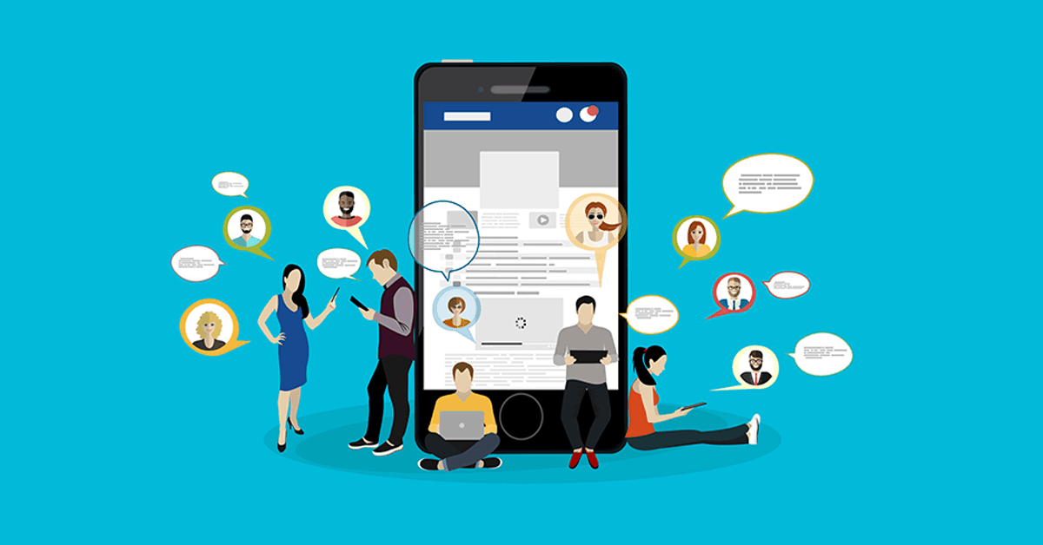
SOCIAL MEDIA ETIQUETTES
SAFELY BROWSING THE WEB
Are you posing/facing online dangers?
How will you avoid these dangers?
How to virtually behave /conduct yourself while browsing web?

Slide 8
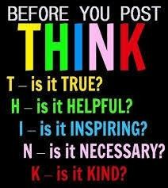

Slide 9
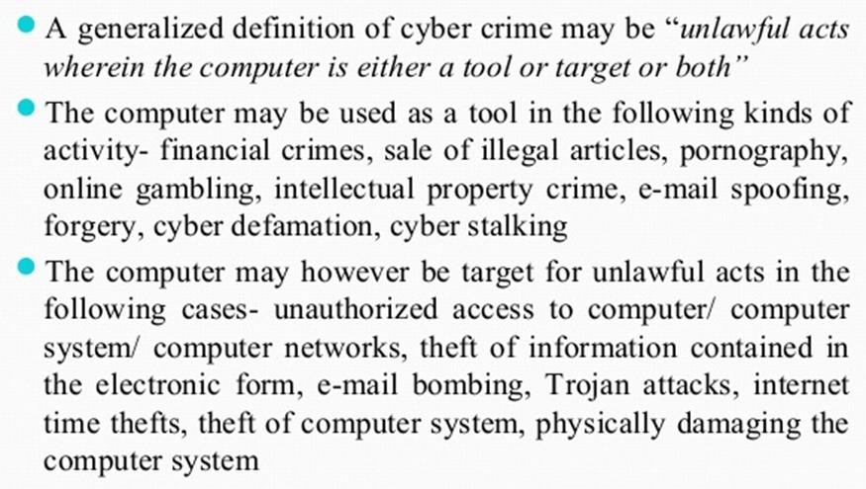
CYBER CRIME
Wikipedia

Slide 10
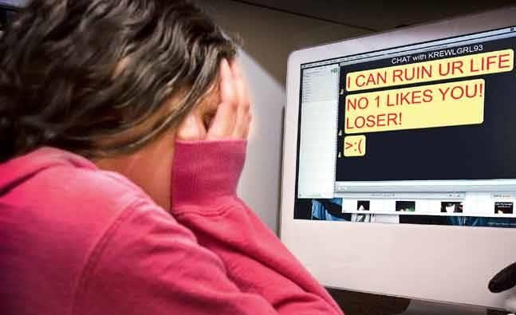
CYBER BULLYING
Harassing, demeaning, embarrassing, defaming or intimidating someone using modern technologies like Internet, cell phones, instant messengers, social networks etc. is called Cyber Bullying

Slide 11
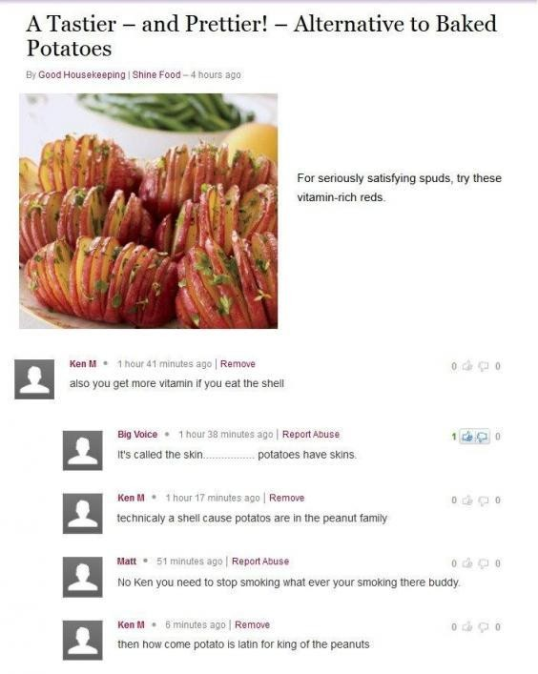
Cyber Trolls
Cyber Trolls refers to a person who purposely posts opposing, sarcastic,demeaning or insuting- comments about somethng or someone with an aim of targeting a person online.
Derogatory messages or comments posted online targeting people are called cyber trolls.
Cyber troll is a cyber crime closely related to cyber bullying.

Slide 12
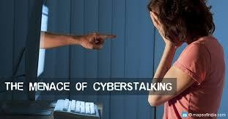
CYBER STALKING
Cyber stalking is a kind of online harassment wherein the victim is subjected to a barrage of online messages and emails.
The repeated use of electronic communications to harass or frighten someone, for example by sending threatening mails.
Cyberstalkers commonly have four objectives:
locate,
surveil,
emotionally harass,
and criminally manipulate their prey.
In some cases, the cyberstalker will prey on their target's family, friends, and coworkers to attack their target.
Examples of Cyberstalking:
Mark Zuckerberg has been stalked by Pradeep Manukonda

Slide 13
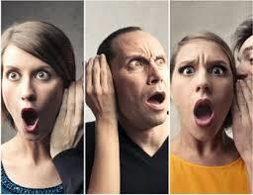
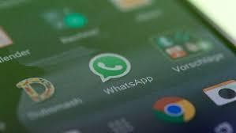
SPREADING RUMOURS ONLINE
People create fake profiles and indulge in posting false information on social media, or comments that could hurt others or spread rumours that may trigger panic or hurt religious sentiments of other people resulting into clashes and even riots etc.
Spreading rumours online is a cybercrime and is a punishable offence. As per IT Act of India, Publishing/circulation of Rumours, especially hurting religious sentiments is a cybercrime and may invite a fine with imprisonment extendable upto 3 years.

Slide 14
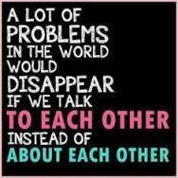

Slide 15
REPORTING CYBERCRIME
If any cybercrime happens , one must report it firstly to the members of his/her safety net (to parents, school authorities) and then to police. The procedure for reporting cybercrimes is more or less the same as for reporting any other kind of offence.
Local police stations can be approached for filing complaint just as the cybercrime cells.
Filing of ‘E-FIR’ in most of the states of India.
Launch of new website by Ministry of Home Affairs for registering crime against women and children online including cybercrimes

Slide 16
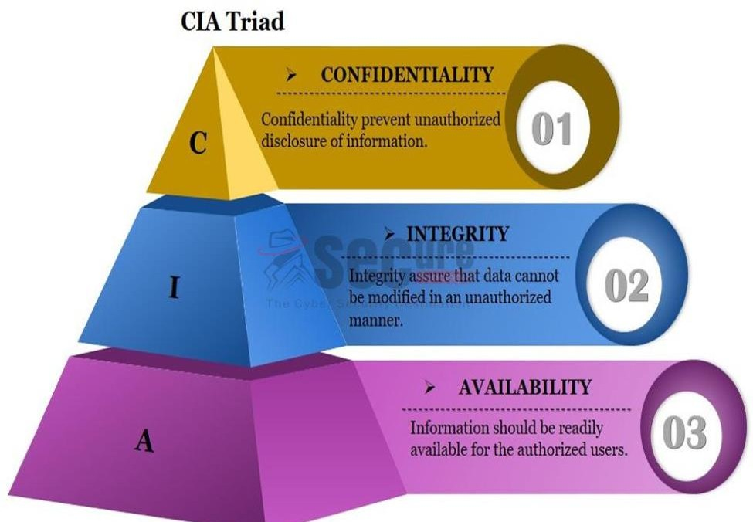
CONFIDENTIALITY
Confidentiality prevent unauthorized disclosure of information.
INTEGRITY
Integrity assure that data cannot be modified in an unauthorized manner.
AVAILABILITY
Information should be readily available for the authorized users.

Slide 17
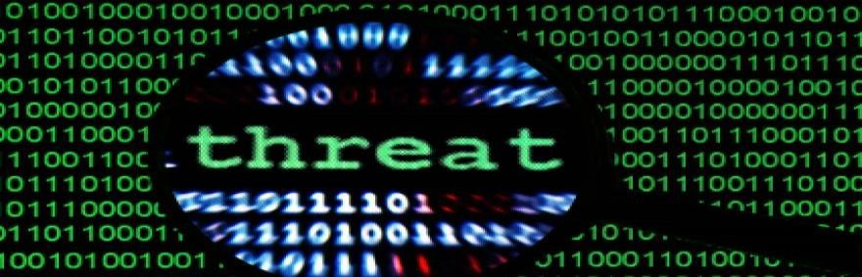
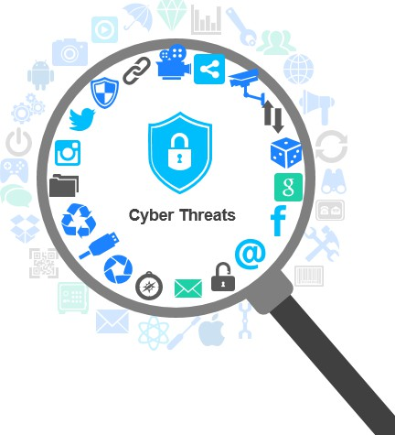
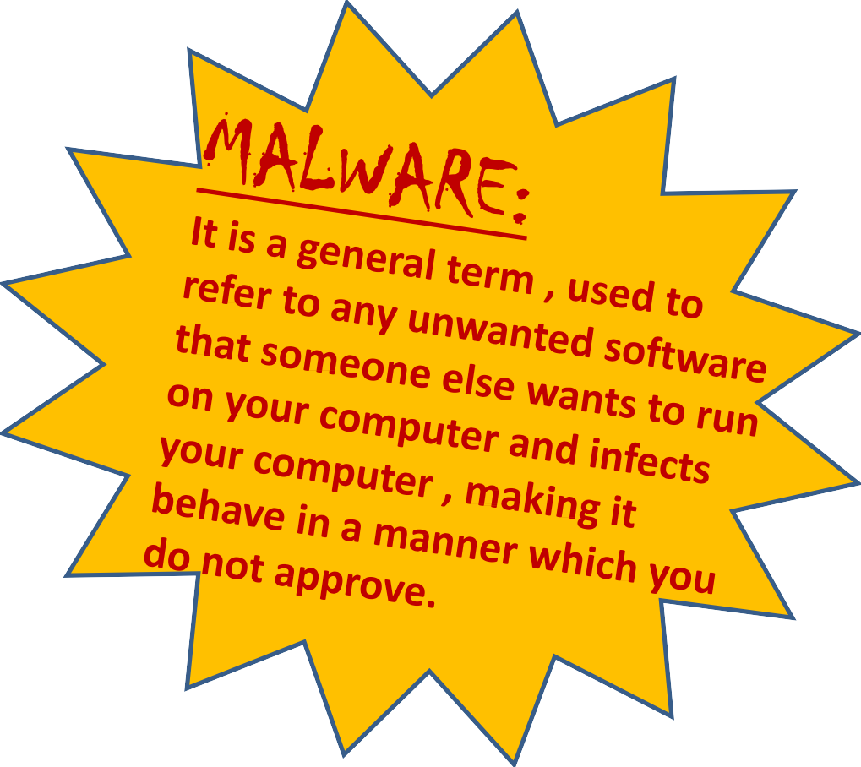
A threat is a potential violation of security. When a threat is actually executed, it is known as attack.
Some common threats (MALWARES):-
  Viruses ,Worms,Trojan Horse
  Spyware
  Adware
  Spamming
  PC Intrusion:
    Denial of Service
    Sweeping attack
    Password guessing
  Phishing

Slide 18
VIRUS: Computer viruses are malicious codes/ programs that cause damage to data and files on a system. It can attack any part of a computer’s software such as a boot block, OS, system areas, files and application-program-macros etc. It needs a host/ carrier application/program. Damages or deletes files Slow down your PC Invade your email program WORMS: It is a self-replicating program which eats up the entire disk space or memory and keeps on creating its copies until all the disk space or memory is filled. TROJAN HORSE: A Trojan horse is a program that appears harmless (such as a text editor/ screen saver or a utility program) but actually performs malicious functions such as deleting or damaging files at the background, which the user is usually unaware of. | Salient Differences
 | Computer Virus: Needs a host file Copies itself Executable
 | Network Worm: No host (self-contained) Copies itself Executable
 | Trojan Horse: No host (self-contained) Does not copy itself Imposter Program

Slide 19
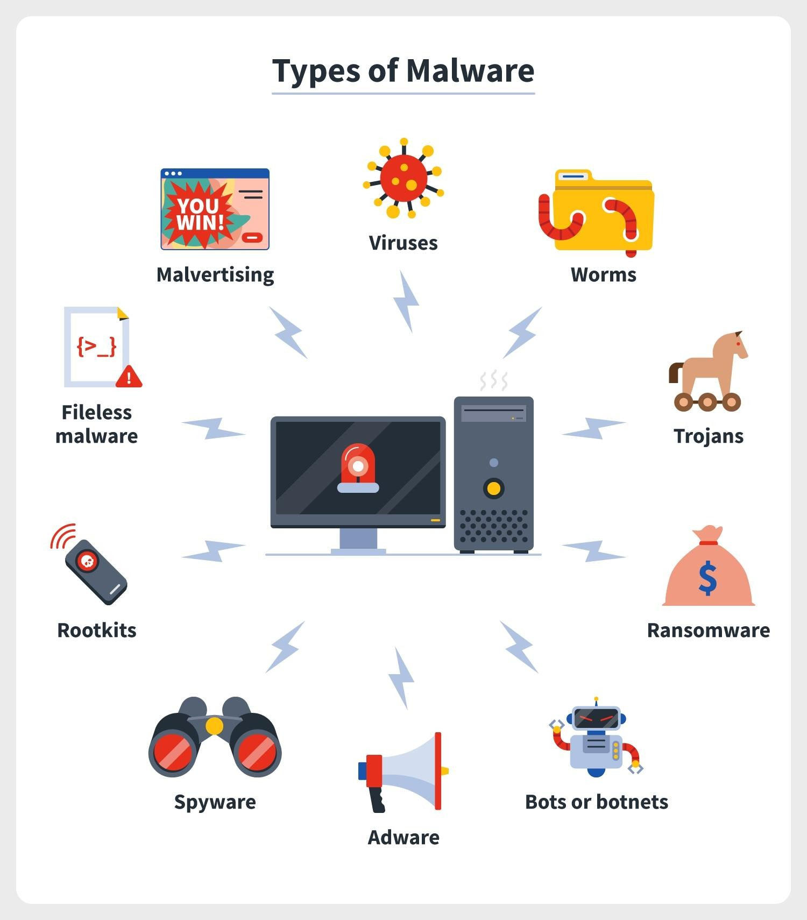

Slide 20
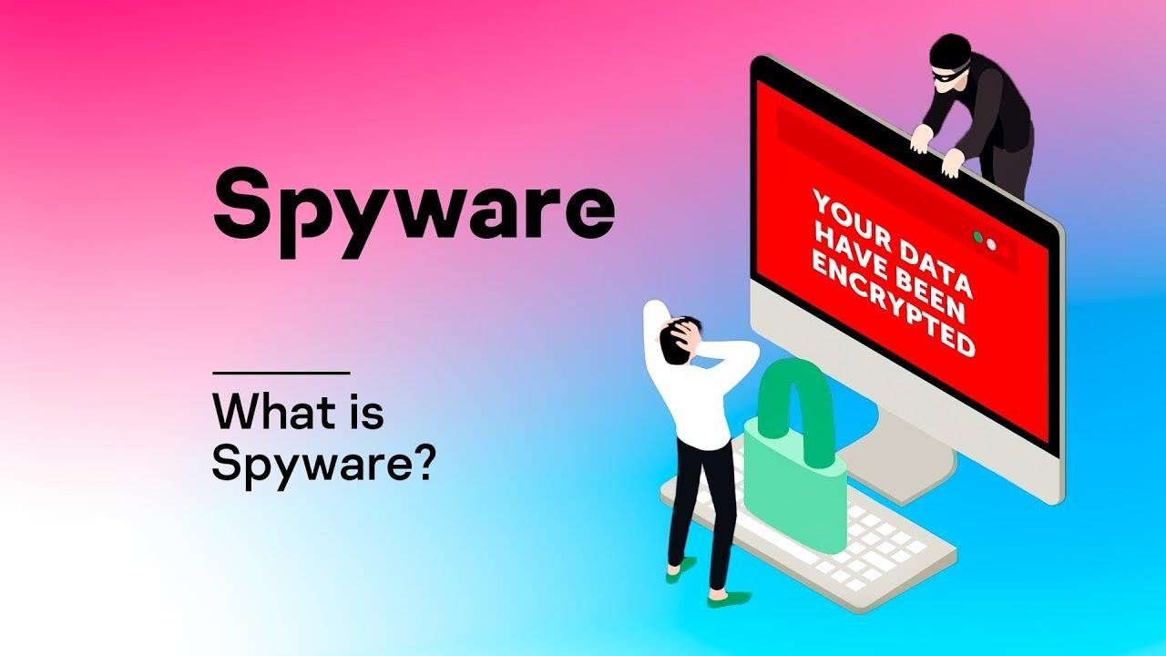
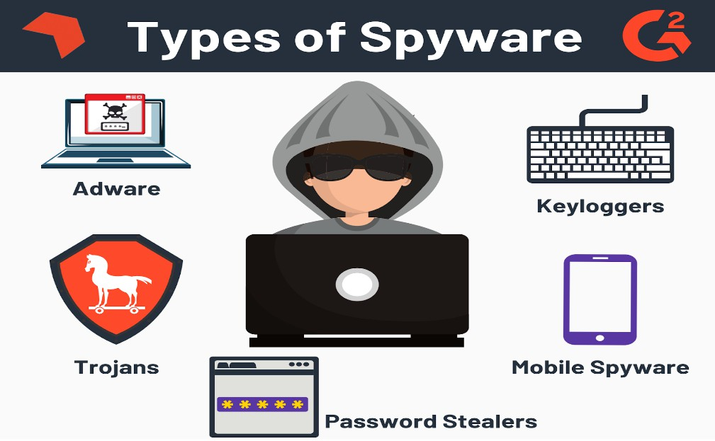
Spyware is software with malicious behavior that aims to gather information about a person or organization and send it to another entity in a way that harms the user.
For example, by violating their privacy or endangering their device's security.

Slide 21
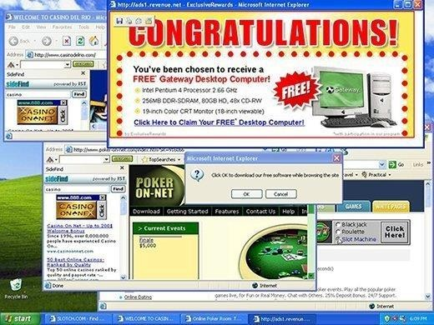
ADWARE
Adware is unwanted software designed to throw advertisements up on your screen, most often within a web browser.
Adware, often called advertising-supported software by its developers, is software that generates revenue for its developer by automatically generating online advertisements in the user interface of the software or on a screen presented to the user during the installation process.

Slide 22
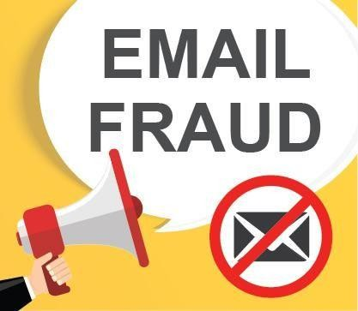
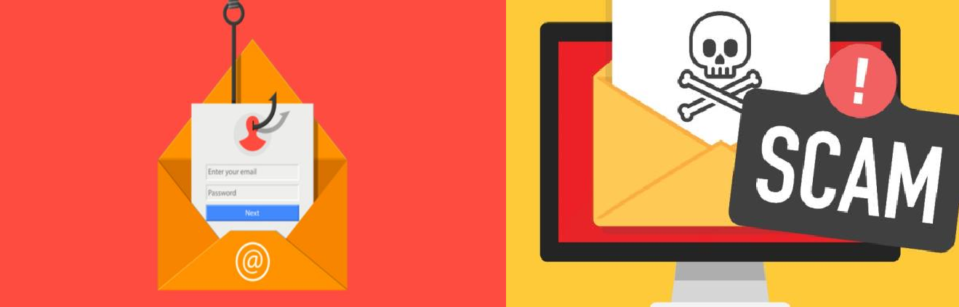
FRAUD EMAILS
Email fraud (or email scam) is intentional deception for either personal gain or to damage another individual by means of email. Almost as soon as email became widely used, it began to be used as a means
to defraud people.
Email fraud can take the form of a "con game", or scam. Confidence tricks tend to exploit the inherent greed and dishonesty of its victims. The prospect of a 'bargain' or 'something for nothing' can be very tempting.
Email fraud,' usually targets naive individuals who put their confidence in schemes to get rich quickly.
These include 'too good to be true' investments or offers to sell popular items at 'impossibly low' prices.
REMEMBER→ Many people have lost their life savings due to fraud. So, DON’T GET TRAPPED IN FRAUD EMAILS.

Slide 23
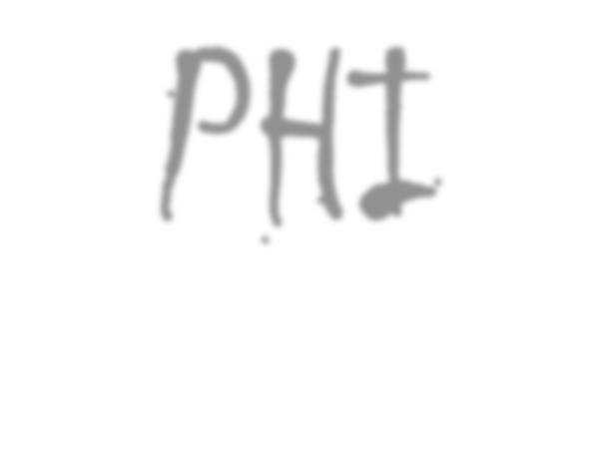


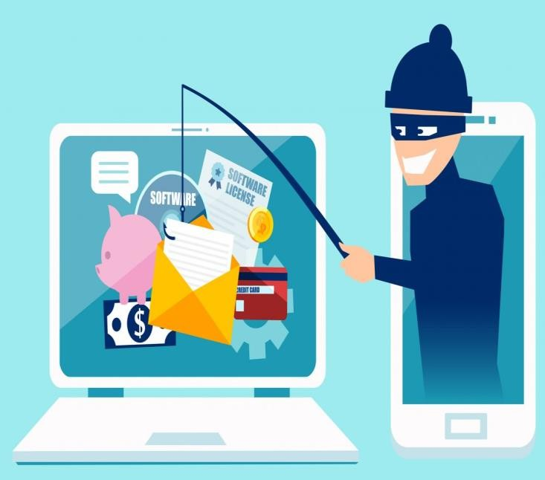
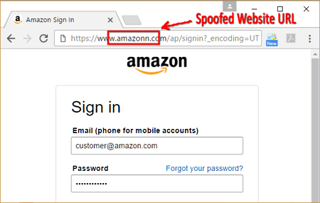
PfiISfiING
Phishing refers to a criminally fraudulent process of attempting to acquire sensitive information such as usernames, passwords, credit card information, account data etc.
In phishing , an imposter uses an authentic looking email or website to trick recipients into giving out sensitive personal information.

Slide 24
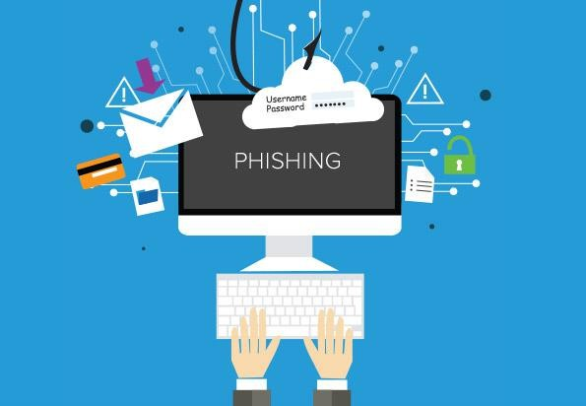
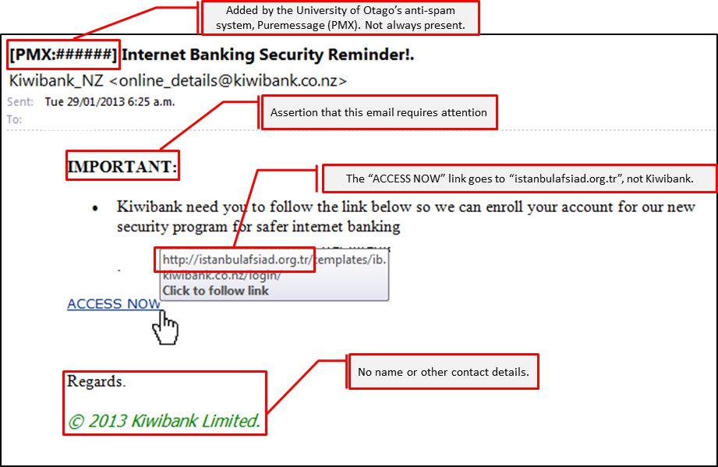

Slide 25
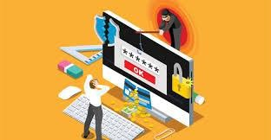

Slide 26
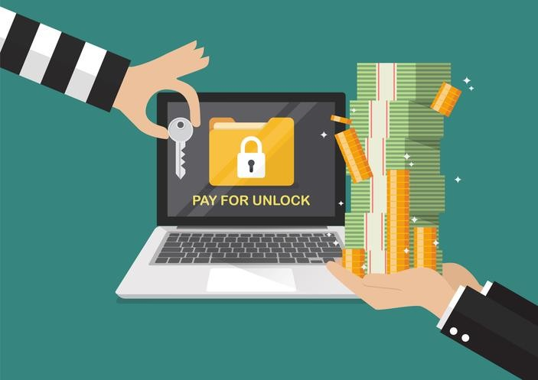
RANSOMWARE
Ransomware is malware that infects devices and locks users out of their data or applications until a ransom is paid. This is costly for businesses because they may have to pay a large sum of money to regain access to their files. It has been revealed that some users have paid enormous fees to obtain the decryption key.

Slide 27
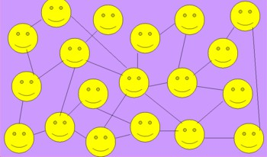

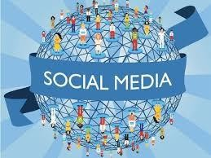
COMMON SOCIAL NETWORKING SITES
A social networking service (also social networking site, or SNS or social media) is an online platform which people use to build social networks or social relations with other people who share similar personal or career interests, activities, backgrounds or real-life connections.
People who have set up their profile on the same platform are called as online friends.

Slide 28
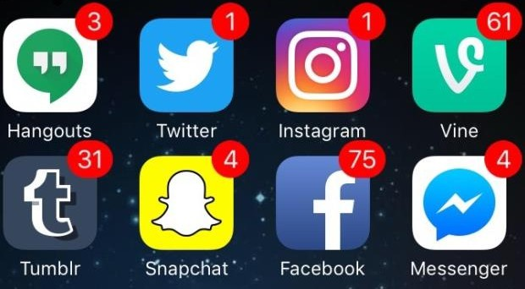


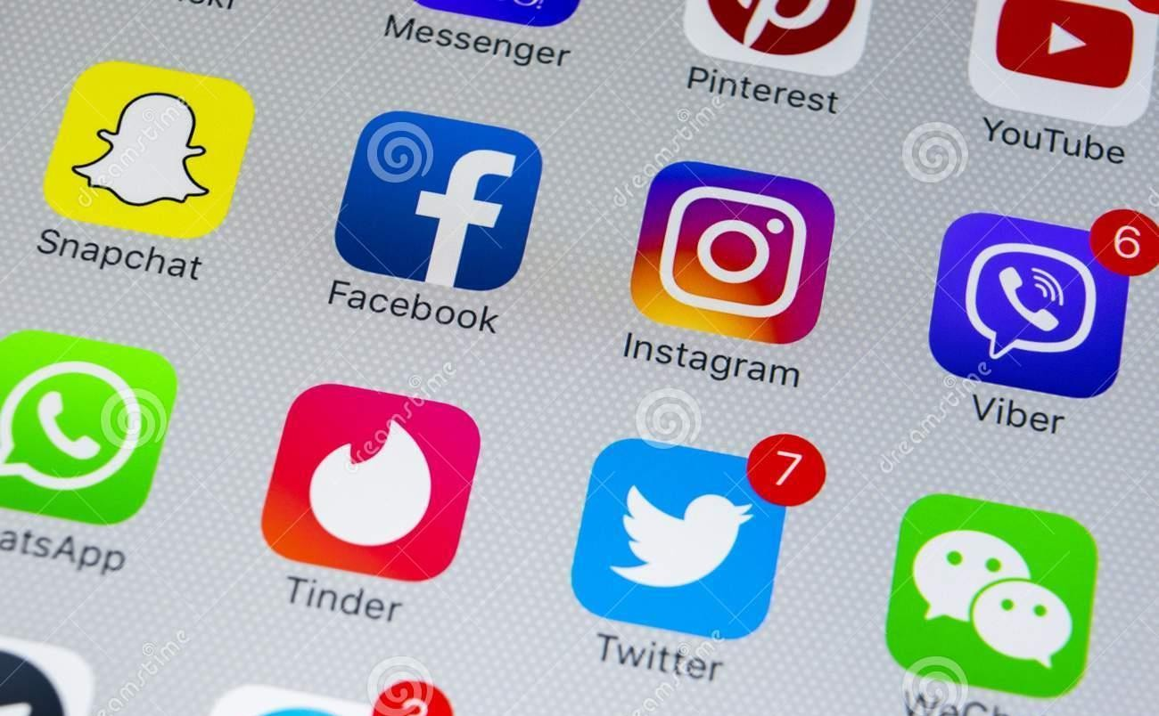

Slide 29

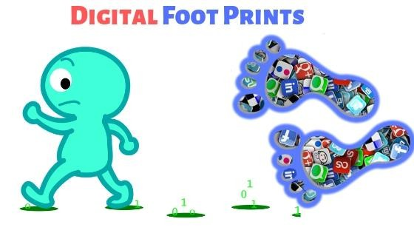

APPROPRIATE USAGE OF SOCIAL
NETWORKS :
DIGITAL FOOTPRINT
Our life is totally dependent on Social media- either directly or indirectly. But, if anyone thinks that he/she will remain entirely anonymous and pose a threat to others then, he/she is in absolute fool’s paradise. Let’s see how...
DIGITAL FOOTPRINT:
Whatever we do online, either post something or visit friends’ pages or search anything on Internet etc. leaves a permanent foot print and it remains for years storing trails of our online activities.
Digital footprints are the records and traces individuals’ activities which are stored permanently as they use the Internet. These footprints may pose potential threat / danger at a later stage in your personal/professional life.

Slide 30

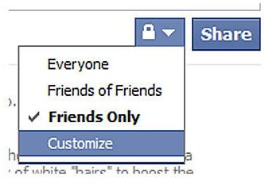
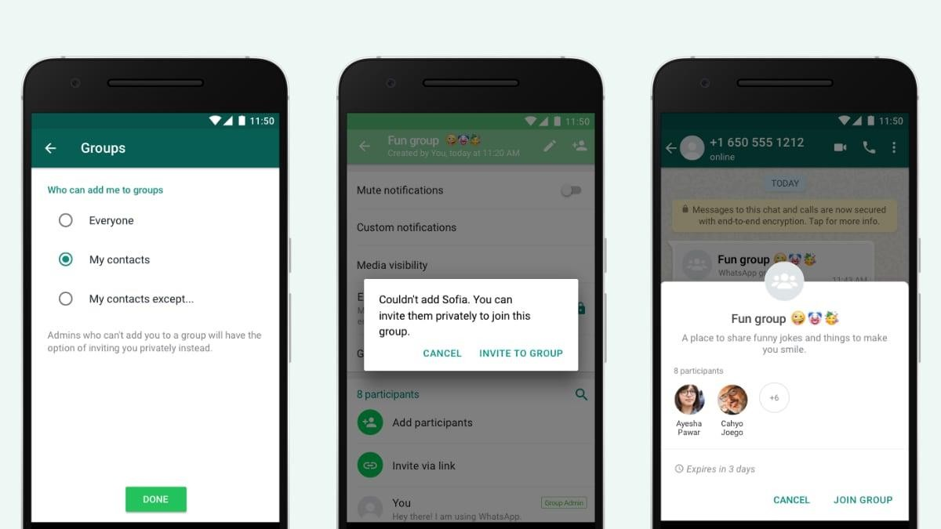
Privacy settings
Just remember to change the default privacy settings and set-up your own privacy settings for all types of social media platforms yourself, so that you can control,
Who all can see what you have posted
Who all can send requests to you
What all information about you is visible to others, even to your contacts etc.

Slide 31

DATA PROTECTION
CONFIDENTIALITY OF INFORMATION
Ensures that only authorized users get access to sensitive and
protected data.

Slide 32
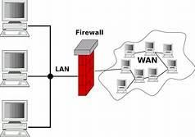
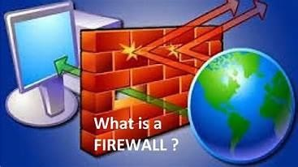



Practices to Ensure DATA PROTECTION
(Confidentiality of information)
Use firewall wherever possible
Control browser settings to block tracking
Browse privately wherever possible
Be careful while posting on Internet
Ensure Safe sites while entering crucial information
Carefully handle emails
Do not give sensitive information on wireless networks 8)
Avoid using public computers
Browse privately
Don’t save your login information
Never save passwords while working on a public computer
Avoid entering sensitive information onto a public computer
Don’t leave the computer unattended
Disable the feature that stores passwords
Properly log out before you leave the computer
Clear history and cookies.

Slide 33
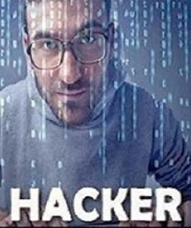
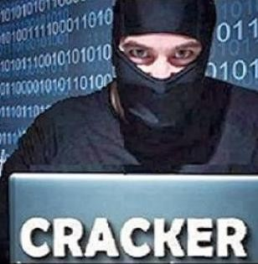
HACKING (HACKER) & CRACKING (CRACKER)
HACKERS | CRACKERS
Hacker is a person who are interested in gaining knowledge about computer systems and possibly using this knowledge for playful pranks. | Cracker is a malicious programmer who gains unauthorized access to a computer system or secured systems for the purpose of stealing and corrupting data.
Hackers enjoy learning the subject to become an expert. This act is known as Hacking. | Crackers do stuff for popularity mainly.
Hackers can be ethical as well as unethical. | Crackers are always unethical, because they do not take permission from anyone as in the case of ethical hacking

Slide 34





SOCIETY runs on
INFORMATION which is based on
KNOWLEDGE. And knowledge refers to
INTELLECTUAL property of a person. The property in digital form is DIGITAL PROPERTY
Some common Ethical issues related to these information are:
Plagiarism
Intellectual property rights
Digital property rights

Slide 35
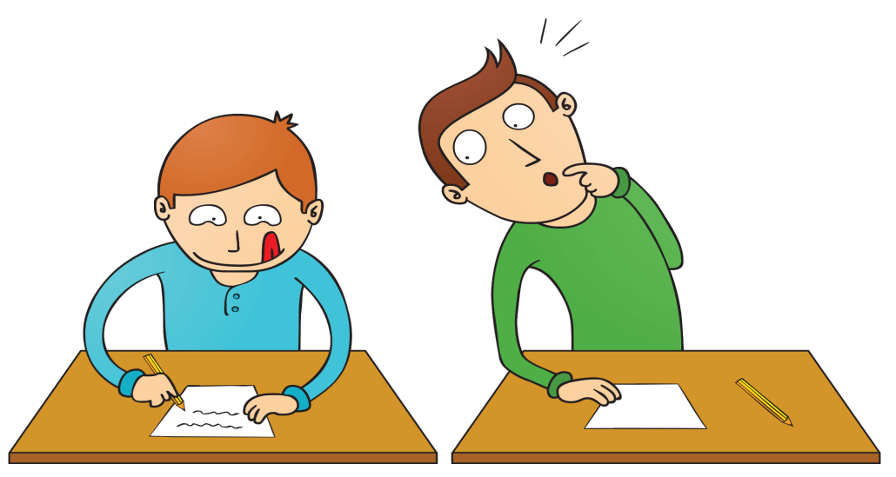
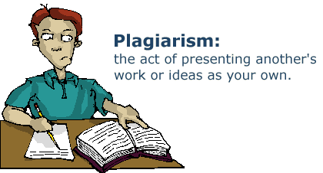
PLAGIARISM
Stealing someone else’s work and presenting it to others as your own work without acknowledging the creator of the work i.e. source of the information.
Some acts of plagiarism:
Using some other work as your own without giving credit to the author
Using someone else’s work in a incorrect distorted form than the intended original
form.
Modifying someone else’s music composition without attributing it to the creator
of the work.
Giving incorrect source of information or wrongful citation about the source
Failure in giving credit or acknowledging the contribution of others in a
collaborative effort, to which you are also part of.

Slide 36
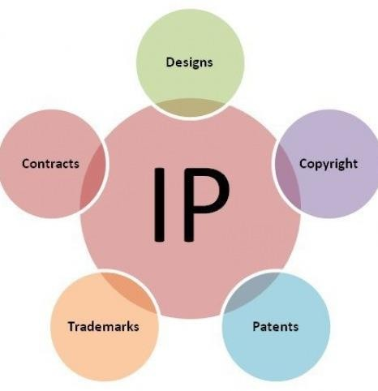
INTELLECUAL PROPERTY RIGHTS (IPR)
Intellectual Property: Property which comes from the Human Brain and for which Government gives protection is called as Intellectual Property.
Intellectual Property Rights: IPR are the Rights of the owner of information to decide how much information is to be shared, distributed or exchanged. Owner can also decide the price for sharing the intellectual property.
The creator/producer of the information is the real owner of the information and has every right to safeguard his/her intellectual property. The IPR must be protected, for it:
→encourages new software, new software applications by individuals and business organization, as well as improving existing applications
→ensures new ideas and technologies are widely distributed
→promotes investment in the national economy

Slide 37
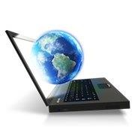
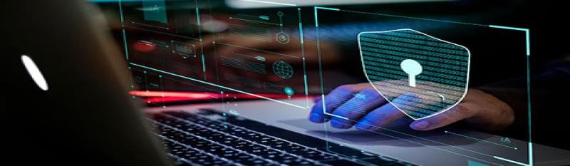
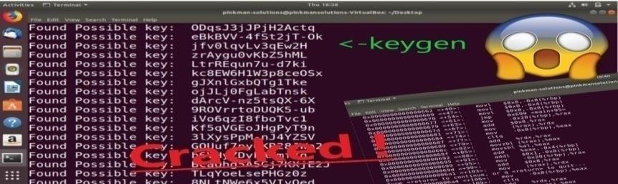
DIGITAL PROPERTY RIGHTS
Digital property (or Digital assets) refers to any information about you or created by you that exists in digital form, either online or in any electronic storage device. Digital property rights lie with the owner who has created it or who has got it developed by paying legally is the owner of a digital property. For Eg: online personal accounts (email), social media accounts & on-line storage accounts etc.
Threats to Digital properties
Digital software penetration tools : Hackers create tools like keygens and cracks to penetrate your digital property, which enables unauthorized (illegitimate) users to freely access the properties
Stealing and plagiarizing codes of your digital properties: Making a plagiarized copy version of your digital software by somehow stealing your digital property.
Digital Property Rights Protection
Anti-temper solutions: prevents hackers from hacking, reverse engineering or manipulating digital properties such utility tools, software apps, video games etc.
Legal Clauses: Term’s of Service that prohibits the scrapping of software are included in the legal
clauses of the Digital properties
Limit the sharing of the software code: Use of DRM solutions and sharing code with only trusted individuals
iii.

Slide 38
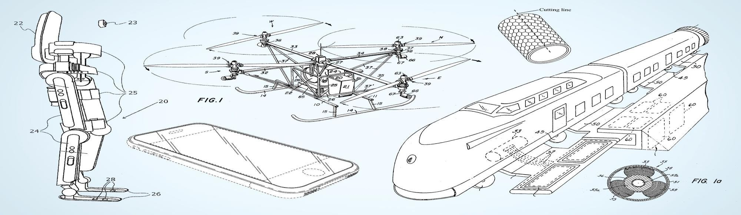
What is a PATENT?
A patent is an exclusive right granted for an invention, which is a product or a process that provides, in general, a new way of doing something, or offers a new technical solution to a problem.
A patent is a right granted to an inventor by the federal government that permits the inventor to exclude others from making, selling or using the invention for a period of time.
The patent system is designed to encourage inventions that are unique and useful to society.
To get a patent, technical information about the invention must be disclosed to the public in a patent application.

Slide 39


COPYRIGHT and
COPYRIGHT INFRINGEMENT
What is a copyright?
Copyright refers to the legal right of the owner of intellectual property. In simpler terms, copyright is the right to copy. This means that the original creators of products and anyone they give authorization to are the only ones with the exclusive right to reproduce the work.
Infringement means: the action of breaking the terms of a law, agreement, etc.; violation.
What is copyright infringement?
A copyright is infringed only when an unauthorized person copies a substantial part of the work.
Some EXAMPLES of COPYRIGHT INFRINGEMENT
Recording a film in a movie theater.
Posting a video on your company's website which features copyrighted words or songs.
Using copyrighted images on your company's website.
Using a musical group's copyrighted songs on your company's website.

Slide 40






TRADEMARK and TRADEMARK INFRINGEMENT
What is a Trademark?
A trademark can be any word, phrase, symbol, design, or a combination of these things that identifies your goods or
services and distinguishes them from others. The trademark owner can be an individual, business organization, or any legal entity.
What is Trademark Infringement?
Trademark infringement is the unauthorized usage of a mark that is identical or deceptively similar to a registered trademark.

Slide 41
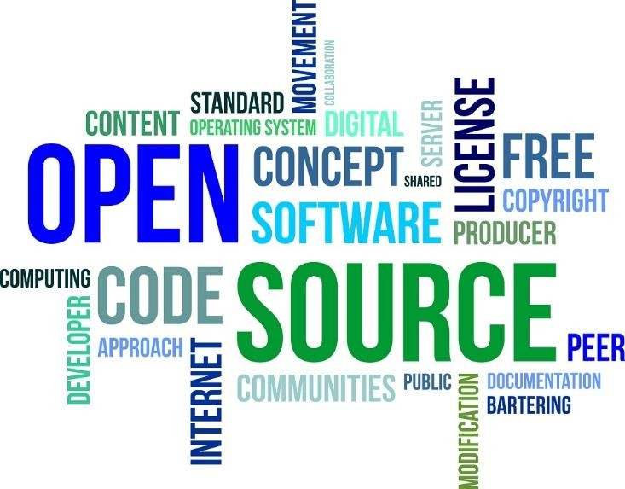

Slide 42










About: FREE and OPEN Source Software (FOSS)
Some Related Terms
Free Software:-
It means the s/w is free of cost which is freely accessible and can be freely used, changed, copied and distributed by all who wish to do so.
Open Source Software(OSS):-
An open software is also available freely i.e its source code is available freely and one can make modifications to it and can redistribute it with different name. But if anyone wants for solution of problem on the existing s/w by the manufacturer, it will not be free (it will be with some nominal charges)
FLOSS(Free Libre Open Source Software):-
A Software which is both free of cost and Open source software i.e. source code is available.
4) Proprietary Software):-
A Software which is neither free of cost nor available for Public. There is a proper license attached to it which user has to buy in order to use it.

Slide 43




About: FREE and OPEN Source Software (FOSS)
Some Related Terms
Shareware / Trialware / Demoware:-
  This software is made available with the rights to distribute copies, but if anyone intends to use the software , then after a certain stipulated time period, a license fee should be paid.
  Its source code is not allowed and hence its modification is not allowed. “Trial version before you buy it”.
Freeware
  This software is free of cost.
  It allows copying and further distribution, but still under owner’s control, i.e. Copyrighted.
  Its source code is not available, hence no modification is possible.

Slide 44

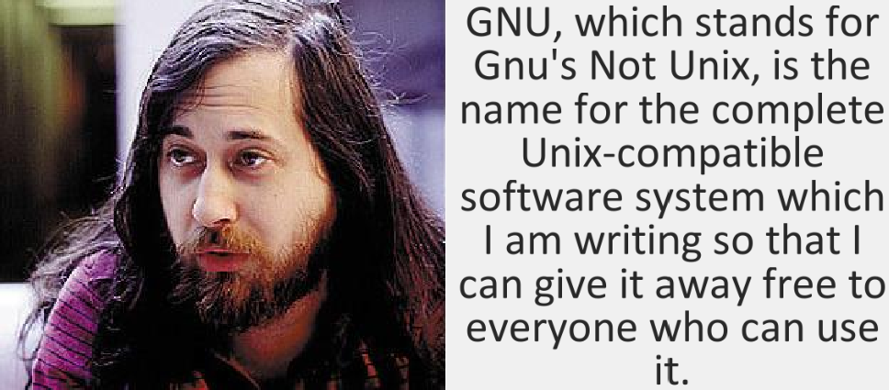

About: FREE and OPEN Source Software (FOSS)
Some Related Terms
GNU stands for
(GNU’s not Unix) ;-
Here, GNU means an animal which is living in freedom. It is a free operating system
identical to Unix but not Unix.
GNU’s Not Unix is a recursive acronym.
FSF(Free Software Foundation) It is a non-profit organization
Richard Stallman
created for the purpose of supporting free s/w movement. It also funds many programmers for developing free s/w.
FSF and GNU both were initiated by Richard Stallman.

Slide 45



About: FREE and OPEN Source Software (FOSS)
Some Related Terms
OSI(Open Source Initiative It is an organization developed for promoting Open source software. It defines criteria and terms for open
source s/w.
W3C (World Wide Web Consortium) :-
It is responsible for producing the s/w standards for world wide web. The World Wide Web Consortium (W3C) is the main international standards organization for the World Wide Web. Founded in 1994 and currently led by Tim Berners-Lee, the consortium is made up of member organizations that maintain full-time staff working together in the development of standards for the World Wide Web. W3C also engages in education and outreach, develops software and serves as an open forum for discussion about the Web.
Tim Berners-Lee

Slide 46


What are LICENSES?
Licenses are the permissions given to use a product or someone’s creation by the copyright holder.
COPYRIGHT and COPYLEFT Licenses

Slide 47



LICENSES AND DOMAINS OF OPEN SOURCE SOFTWARE(OSS) TECHNOLOGY
These licenses allow OSS to be freely used, modified and shared.
GPL: The (GPL) General Public License is the most commonly used license for open-source projects. It allows users to legally copy, distribute and modify software. After modification , one can even charge very nominal for the software, but still it will be under GNU GPL.
LGPL: A (LGPL) Lesser General Public License is a license for open- source software that allows for provisions for including elements of free software in either free or proprietary software. It offers lesser rights then GPL.
**Difference between GPL and LGPL is that the project formed (software extension formed) after modification must be released in case of GPL which is not essential in LGPL.
BSD: The BSD (Berkeley Software Distribution) License lets you freely modify and distribute your software’s code in the source or binary format as long as you retain a copy of the copyright notice, list of conditions, and the disclaimer.(BSD) licenses are used for the distribution of many freeware, shareware and open source software.

Slide 48



LICENSES AND DOMAINS OF OPEN SOURCE
SOFTWARE(OSS) TECHNOLOGY
MIT: The MIT License is a free software license that was created at
the Massachusetts Institute of Technology which grants the software end user rights such as copying, modifying, merging, distributing, etc. It has the restriction that as long as you have license , you can do anything with the software.
** MIT License is the least restrictive Open source License.
CREATIVE COMMONS: A Creative Commons license is one of several public copyright licenses that enable the free distribution of an otherwise copyrighted "work". A CC license is used when an author wants to give other people the right to share, use, and build upon a work that the author has created.
Apache: The Apache Software License (ASL) is a license scheme for free and open-source computer software (FOSS) written by the Apache Software Foundation (ASF). ASL allows projects and software to be freely downloaded and used. The code is distributed openly and is allowed to be freely modified, redistributed or studied. Through open-source code, Apache encourages users to voluntarily improve the design of the software.

Slide 49


DIGITAL FORENSICS
Extra knowledge
“Digital forensics” is a broad term referring to the search for and detection, recovery and preservation of evidence found on digital systems, often for criminal or civil legal purposes.

Slide 50


BIOMETRIC MODALITIES/TRAITS IN DIGITAL FORENSICS
to authenticate an individual

Slide 51


CYBER LAW / IT LAW
Cyber law, or cyber crime law,
is legislation focused on the acceptable behavioral use of technology including computer hardware and software, the internet, and networks.
Cyber law helps protect users from harm by enabling the investigation and prosecution of online criminal activity.
India’s IT Act 2000
In India, cyber laws are enforced through Information Technology Act,2000
It was notified on 17th October 2000.
It is based on United Nation’s Commission for International Trade related laws
(UNCITRAL) model law.
The purpose of IT Act is
  to provide legal recognition to electronic commerce (e-Commerce) and to facilitate filing of electronic records with the Government.
  To provide legal infrastructure for e-commerce in India.

Slide 52
IT(Ammedment) Act 2008
The Act was later amended in December 2008 to provide additional focus on information security i.e. IT Act, 2008. Major amendments are :-
Digital Signatures i.e. authentication of electronic records.
Electronic Governance i.e. E-documents get legal recognition.
Empowered Indian government with the ability to surveil, monitor and block data traffic .
The government will be able to conduct surveillance on corporate networks and e-mail systems, and can intercept, monitor and decrypt
computer systems, resources and communication devices.
The maximum penalty for any damage to computers is fine up to 1crore.
Other amended acts such as IPC 1860, 1872, 1891 and 1934.
The I.T. Act contains 13 chapters and 90 sections.
The last four sections namely sections 91 to 94 in the I.T. Act 2000 deals with the amendments to the Indian Penal Code 1860

Slide 53

E-WASTE MANAGEMENT
➢
E-Waste: Electronic waste describes discarded electrical or
electronic devices. “Electronic waste” may also be defined as discarded computers, office electronic equipment, entertainment device electronics, mobile phones, television sets and refrigerators. This includes used electronics which are destined for reuse, resale, salvage, recycling or disposal.
Electrical and Electronic equipment contains metallic and non metallic elements such as Copper, Aluminum, Gold, Silver, Palladium, Platinum, Nickel, Tin, Lead, Iron, Sulphur, Phosphorous, Arsenic etc.

Slide 54


The recycle and recovery includes the following unit operations
Dismantling involves removal of parts containing dangerous substances, parts containing valuable substances.
Separation of ferrous metal, non- ferrous metal and plastic.
Repair and reuse.
Recovery of valuable materials.
Disposal of dangerous materials.
The e-waste disposal and recycling is very much necessary and important for the benefit of people, environment and the nation.
The key benefits are:-
Allows for recovery of valuable precious
metals
Protects public health and water quality.
Creates jobs
Toxic waste
Saves landfill space.

Slide 55


Awareness about health concerns related to the usage of Technology
1. Digital eye strain
Symptoms of digital eye strain may include:
Negative effects of technology on kids: Too much screen time or low- quality screen time may lead to
  behavioral problems
  less time for play and loss of social skills
  obesity
  sleep problems
blurred vision
dry eyes
headaches
neck and shoulder pain
Violence
Emotional problems
makes you feel anxious or depressed
Sleep problems
Musculoskeletal problems
When you use a Smartphone, the chances are that you’re holding your head in an unnatural forward-leaning position. This position puts a lot of stress on your neck,shoulders, spine and repetitive strain injuries of the fingers,thumbs,and wrists.

Slide 56
MEASURES TO SAFEGUARD FROM NEGATIVE TECHNOLOGICAL EFFECTS
Clear your phone of unessential apps to keep you from constantly checking it for updates.
Take frequent breaks to stretch, create an ergonomic workspace and maintain proper posture while using devices
Carve out a specific, limited amount of time to use your devices.
Turn some television time into physical activity time.
Keep electronic devices out of the bedroom. Charge them in another room. Turn clocks and other glowing devices toward the wall at bedtime.
Make mealtime gadget-free time.
Prioritize real-world relationships over online relationships.
CHECK OUT else you will be WIPED OUT:-
Technology is a part of our lives. It can have some negative effects, but it can also offer many positive benefits and play an important role in education, health, and general welfare.
Knowing the possible negative effects can help you take steps to identify and minimize them so that you can still enjoy the positive aspects of technology.

Slide 57

Technology & Society:
Technologies whose value and impact arise primarily from their use in economic and social sectors. The impacts of Information Communication Technology (ICT) are:
Economic impacts: It include the globalization of production in goods and services, changes in international trade and distribution network, changes in pattern of consumption, virtualization of some products and behaviors and growing the importance of ICT sector within the world. The economic benefit include
– Secure transactions, Ease of availability, Net banking, Global market
Social impact include mass market access to an increased information resources, enhanced, new pattern of work and human settlement and changes in the relationships between government, citizen and the state.

Slide 58



GENDER ISSUES WHILE TEACHING AND USING COMPUTERS
There are several Gender specific issues which must be addressed and taken care of to enforce gender equality in Computer Science education.
Some Gender issues are:-
Lack of representation(under representation) of Females in school (less no. of female teachers in schools)
Lack of motivation and interest in the subject
Lack of Female Role models /leaders /personalities
Lack of encouragement in classroom environment
Preconceived notions / Gender stereotypes/unconscious bias
Lack of Girl Friendly Work culture

Slide 59
SOLUTIONS TO GENDER ISSUES
Take initiatives and encourage more and more girls to take up the subject “Computer Science” as their main subject.
In Computer Labs, give more chance to girls to work on computers by avoiding Gender biasness
Use Gender neutral language in school
Representation of Females in every field and encouraging them to take interest in IT field
Motivate girls to become role models in IT field.

Slide 60

DISABILITY ISSUES WHILE TEACHING AND USING COMPUTERS
Some disability issues are:-
Unavailability of proper teaching aids/materials to teach disabled students (such as braille keyboards,monitors,printers,screen readers, hearing aids etc.)
Lack of special needs teachers to teach and train the differently abled students-
specialized editors,voice assistant softwares etc.
Lack of supporting curriculums in school
Solutions to disability issues are:-
School must be equipped with necessary assistivetools and software and teaching materials
Specially Trained teachers must be appointed
Curriculums must be framed carefully by keeping in mind the specially abled students.
Inclusive education must be promoted in classrooms

Slide 61
Bibliograhy and References
Google
Wikipedia
Quora
geektogeeks
Book: XI Computer Science
  By Sumita Arora, Dhanpat Rai Publication 2020 Edition
Book: XI Computer Science
  By Kips Publication 2021 Edition

Slide 62


Stay safe. Stay aware. Stay healthy. Stay alert.

Slide 63







